Slide 1
DAA Assignment 6 Group 3
Group members
Roll-No. Name Github ID
IIT2019009 | Abhijeet Sonkar | Abhijeet-sonkar
IIT2019007 | Aditya Raj | Adityahulk
IIT2019008 | Shyam Tayal | shyamTayal

Slide 2
Contents –
Problem Statement
Introduction
Algorithm Design and Analysis
Time and space complexity analysis
References

Slide 3
Introduction -
DFS and Floyd Warshall Algorithm
Depth-first search (DFS) is an algorithm for traversing or searching tree or graph data structures. The algorithm starts at the root node (selecting some arbitrary node as the root node in the case of a graph) and explores as far as possible along each branch before backtracking.
The Floyd Warshall Algorithm is for solving the All Pairs Shortest Path problem. The problem is to find shortest distances between every pair of vertices in a given edge weighted directed Graph.

Slide 4
Problem Statement -
Given a directed graph, find out if a vertex v is reachable from another vertex u for all vertex pairs (u, v) in the given graph. Here reachable mean that there is a path from vertex u to v. The reach-ability matrix is called transitive closure of a graph.

Slide 5
Algorithm Design and Analysis
Steps of doing DFS:-
Start by putting any one of the graph's vertices on top of a stack.
Take the top item of the stack and add it to the visited list.
Create a list of that vertex's adjacent nodes. Add the ones which aren't in the visited list to the top of the stack.
Keep repeating steps 2 and 3 until the stack is empty.
Steps of Floyd-Warshall:-
We initialize the solution matrix same as the input graph matrix as a first step. Then we update the solution matrix by considering all vertices as an intermediate vertex. The idea is to one by one pick all vertices and updates all shortest paths which include the picked vertex as an intermediate vertex in the shortest path.

Slide 6
Time and space complexity analysis -
 | Time Complexity | Space Complexity
DFS | O(N^2) | O(N^2)
Floyd Warshall | O(N^3) | O(N^2)

Slide 7
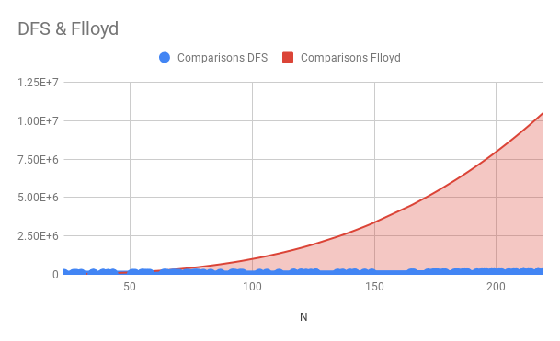
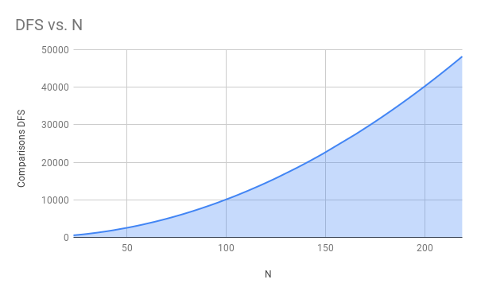
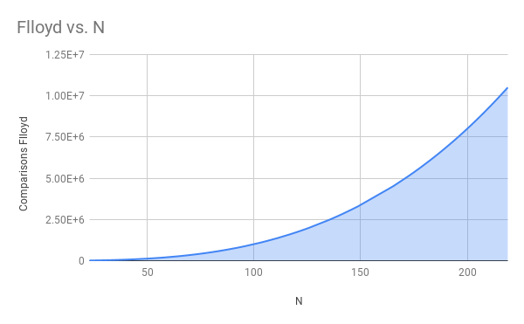

Slide 8
References
https://en.wikipedia.org/wiki/Floyd\%E2\%80\%93Warshall\_algorithm
https://www.geeksforgeeks.org/depth-first-search-or-dfs-for-a-graph/

